Slide 1
Perl jam
“It's not that Perl programmers are idiots, it's that the language rewards idiotic behavior in a way that no other language or tool has ever done.”
- Erik Naggum

Slide 2
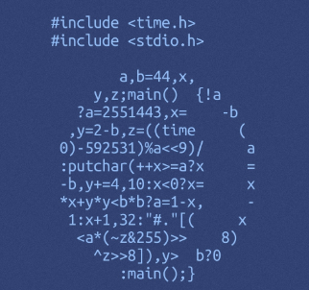
What does this code do?

Slide 3
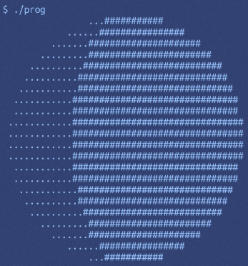
Prints the current phase of the moon

Slide 4
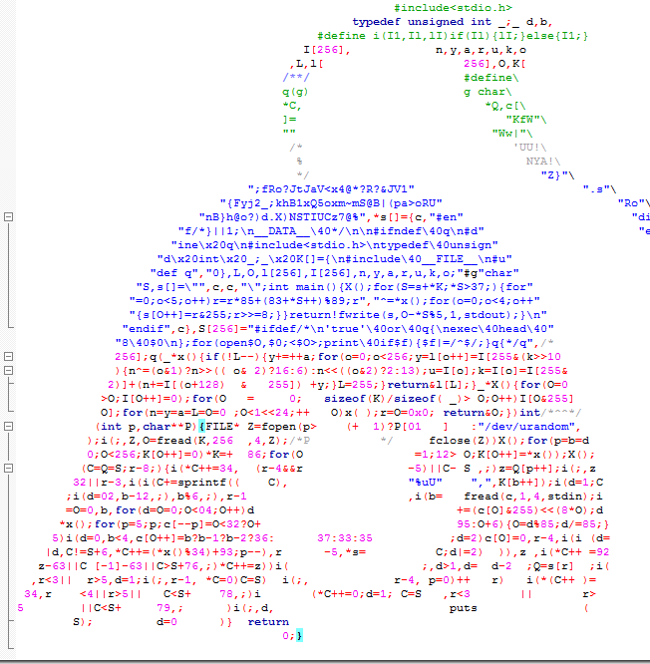
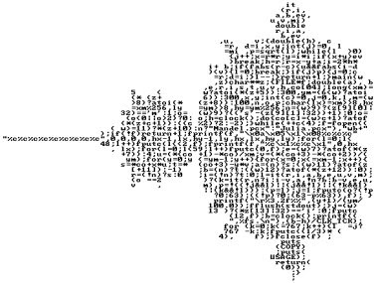
The International Obfuscated C Code Contest
Write the most confusing code. https://www.ioccc.org/index.html

Slide 5
perl
“If Perl is the solution, you're solving the wrong problem.”
- Erik Naggum
- General purpose scripting language
System administration, parsing logs, web development, finance apps (AAAAH!), bio informatics.
- Popular in the 80s, 90s, still used today.
- Comes pre-installed on Mac/Linux
- Excellent support for text manipulation
- Notorious for convoluted development. Famous for being “write only” haha.
“The camel has evolved to be relatively self-sufficient. On the other hand, the camel has not evolved to smell good. Neither has Perl.”
- Larry Wall – inventor of Perl
“There's really no way to fix this and still keep Perl pathologically eclectic.”
- Larry Wall

Slide 6
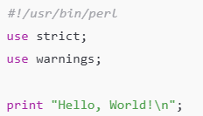

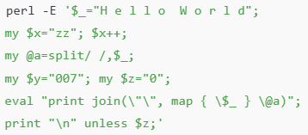

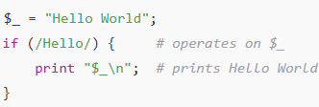

Perl examples

Slide 7
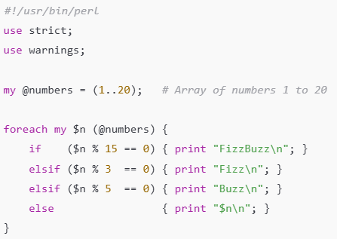
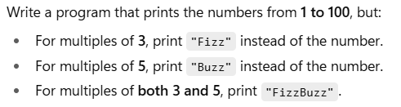
Perl examples – Fizz buzz

Slide 8

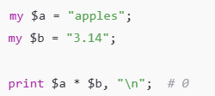

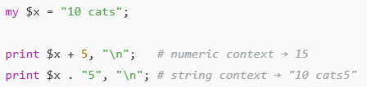
Perl type abuse

Slide 9
Lab requirements
* Write the most confusing code possible in the Perl language.
* Make something ugly, vile, creative, and deceptive. No line requirement, just make it disgusting.
* Do NOT discuss with your classmates.
* No vibe coding. DO NOT USE AI.
* Send the following to richard.thompson@nps.edu
Github link. It must run. If there are any special flags to run, let me know.
A brief list of three things you did to obfuscate your code. Three things for an A, Two things for a B, One thing for a C.
Do not tell me what it does in the email.
* In class we will do a code demonstration where I will roast you. After a period of ‘admiring’ your code, we will give you a chance to explain how it works. You must be able to explain how it works. There will be prizes for the worst (best) coders!

